Slide 1
Parent Forum Workshop March 2017 Age Related Expectations
By
Sarah Amran

Slide 2
My role at Darlinghurst School
Teaching 20 years
Member of SLT
Assessment Lead
NQT mentor
LOtC Lead

Slide 3
Aims of this session
To understand how we assess at a primary level and Age Related Expectations (ARE)
To understand how we assess at Darlinghurst School
To share how we deliver marking and feedback to your child/children

Slide 4
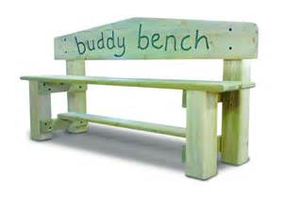
What does assessment mean?
The word assess comes from the Latin assidere, which means to sit beside.
Assess means to sit beside the learner!

Slide 5
Primary Assessment
Formative Assessment
Summative Assessment

Slide 6
Formative Assessment
On-going, formative assessment has an enormous impact on pupil attainment and progress.
At Darlinghurst school we expect high quality…
written and verbal feedback
questioning to challenge/ clarify/deepen understanding
subject knowledge from our staff
tracking of attainment and progress against Age Related Expectations (ARE)

Slide 7
Darlinghurst’s marking policy… Assess > Plan > Teach
Tickled Pink: identifies what a pupil has done well
Green for Growth: identifies what a pupil needs to do to improve
Then…
Evidence of visible signs of improvement that comes from the marking
We feel it is invaluable to involve our pupils in this process.

Slide 8
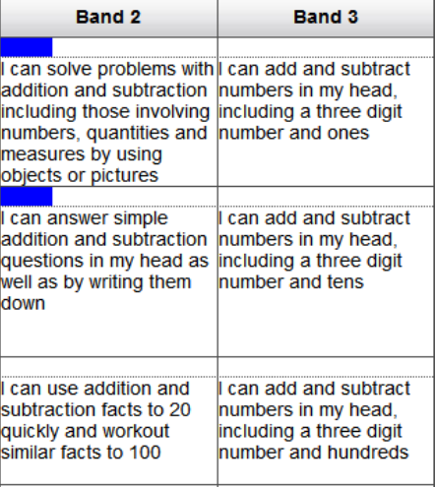
Target Tracker – our in-school tracking system
During PPA time staff assess against the new National Curriculum ARE statements on TT for every child
Conduct gap analysis
Plan for challenge/intervention
Check curriculum coverage
Track pupils individually

Slide 9
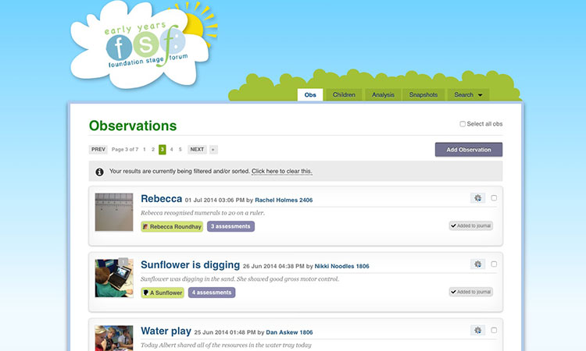
Assessment arrangements for EYFS
Tapestry (on-line I-Pad app documenting a pupil’s Early Learning Journey )
7 Areas of Learning from ‘Development Matters’
EYFS Profile: Early learning goals, which summarise the knowledge, skills and understanding that all young children should have gained by the end of the Reception year and their readiness for Year 1
(See Development Matters Example)

Slide 10
Summative assessments
Hot and cold tasks – Writing Assessment
Pre and post tests, e.g. Maths Mastery Unit tests
SATs revision, CPG Tests
Half termly tests, e.g. Maths PUMA, Rising Stars Reading Comprehension, GPS
Target Tracker TA and raw scores

Slide 11
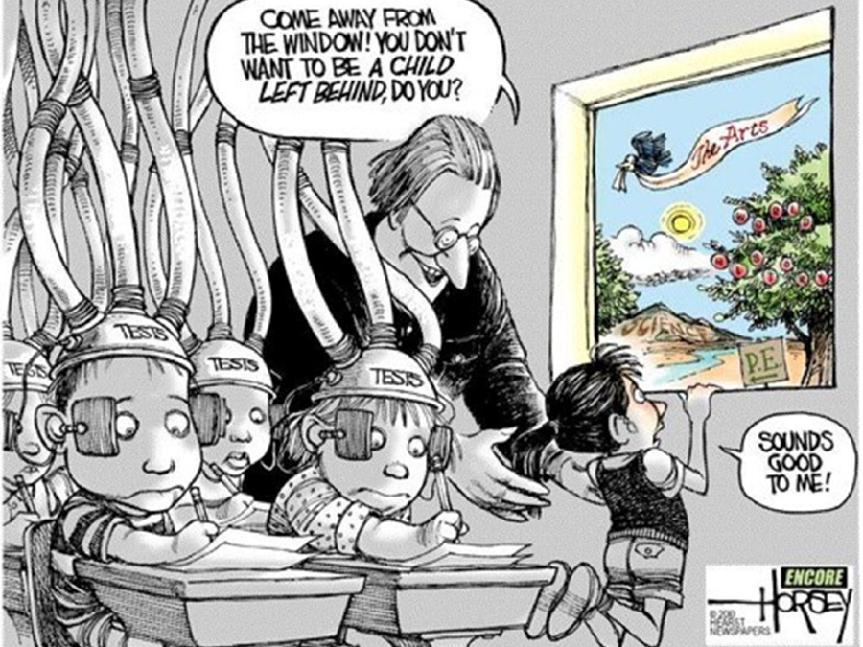
(Source: kieranearley.co.uk)
Summative tests are only used to…
support a teacher’s assessment
expose pupils to test formats
identify gaps/strengths in knowledge
track progress against prior attainment groups

Slide 12
Summative Assessment on Target Tracker
Every half term teachers make a summary judgement about the achievement of pupils in Reading, Writing and Maths

Slide 13
Attainment Grades
Age Related Expectations | Description | What this looks like
WTS | Below age related expectation | Unable to access age related activities even with support
 | Just below age related expectation | Able to access age related activities with adult or peer support
EXS | Working at age related expectation | Able to independently achieve the majority of objectives taught
 | Working just above age related expectation | Able to confidently apply learning within the context taught
GDS | Secure understanding of age related expectation | Able to apply learning independently in different contexts
 | Highly secure understanding of age related expectation | Demonstrates depth of understanding in the application of basic skills in any context.

Slide 14
Cycle of moderation
Internally – during staff meetings, within year groups and across phase
Cluster groups – local primary schools
External moderation – LA
Standards and Testing Agency have released TA exemplification documents
Notes:
Because this is a new assessment system all Primary schools have been able to create their own assessment system so it’s really important that we meet regularly to ensure our judgements are in line. Government has just released some exemplification material for Year 2 and Year 6 teachers to use when Teacher Assessing. Although it is only one piece of evidence, would you say this pupil was ‘working toward’ ,‘working at’ or ‘working at greater depth’?

Slide 15
Reporting to parents
Mid-term reports share:
whether a pupil is not on-track (WTS), on track (EXS) and on track to exceed ARE by the end of the academic year
a pupil’s learning behaviours and personal achievements
End of year reports share more detailed about attainment in core subjects and personal achievements (these may change in format for Summer 2017)

Slide 16
Have the needs of my audience been met?
Video

Slide 17
The End
https://www.youtube.com/watch?v=AlaN-KH1Pcg

