Slide 1
Key Stage 1 National Curriculum Assessments
Wednesday 26th April 2017

Slide 2
Outline
What are the SATs?
An outline of the tasks and tests, including
examples
Teacher assessment
What you can do to help
Q&A

Slide 3
What are SATs?
The school is required to administer SATs throughout May, and all schools in England will be carrying out SATs at this time.
SATS are a series of tests taken by all Year Two children and if a child is absent they will complete the test on their return.
Children are assessed in the following: Reading Mathematics
SPAG (punctuation and grammar)

Slide 4
Teacher Assessment
In KS1 the emphasis is on teacher assessment. Although the tests support teachers’ judgements, assessments are based on a child’s performance throughout the academic year.
Children will not know that they are taking SATs. We do not use this term and refer instead to special challenges or booklets.
• Children are given time to complete as much of the paper
as possible (no constraints & breaks)

Slide 5
Reading
The Reading Test consists of two separate papers:
• Paper 1 – Contains a variety of short texts with questions.
• Paper 2 – Contains a separate reading booklet.
Children will write their answers to questions about the passage
in a separate booklet.
• The texts will cover a range of poetry, fiction and non-fiction.
• Questions are designed to assess the comprehension and
understanding of a child’s reading.

Slide 6
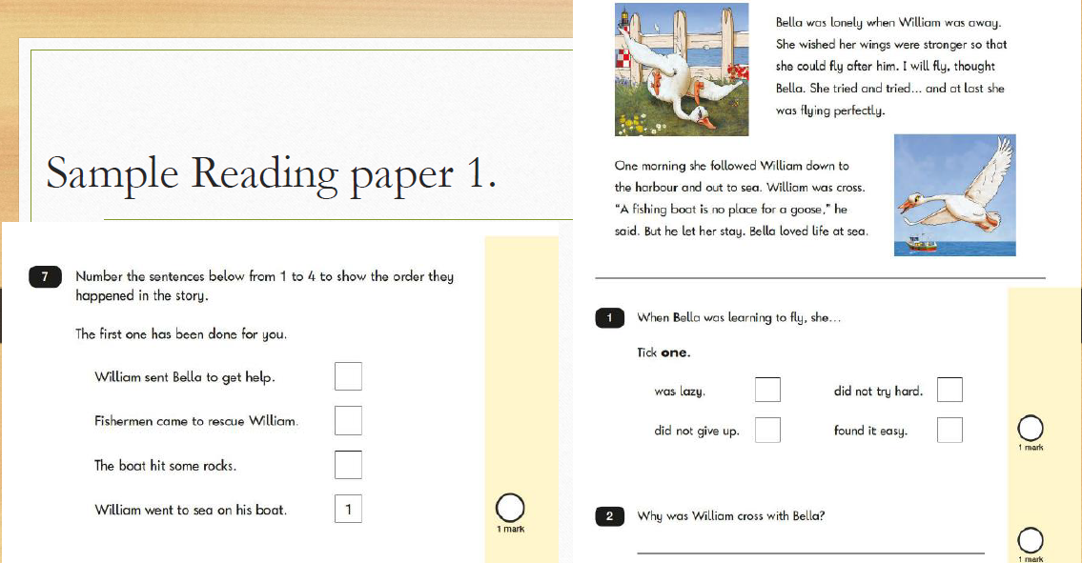
Sample Reading Paper 1

Slide 7
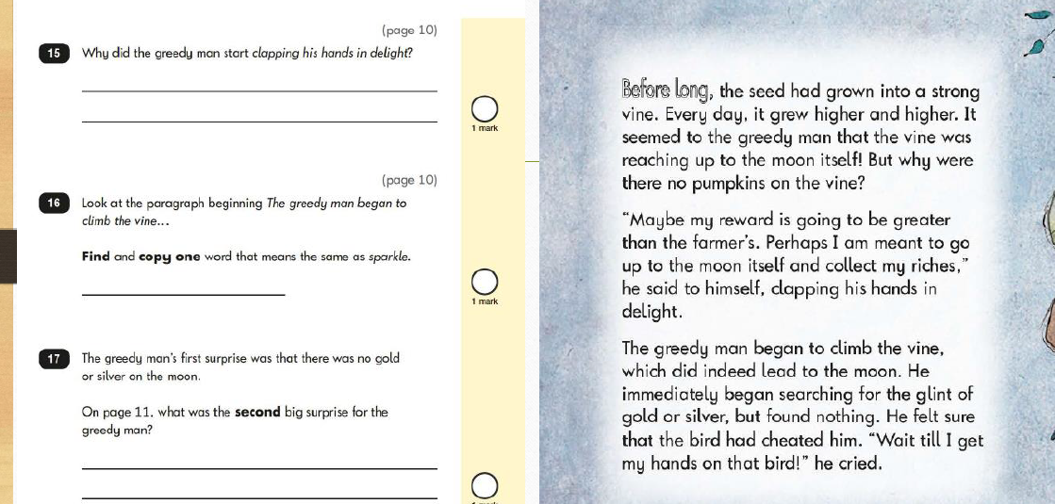
Sample Reading Paper 2

Slide 8
Spelling Punctuation and Grammar
This test consists of two separate papers:
• Paper 1: spelling (20 marks).
• Paper 2: questions (20 marks).

Slide 9
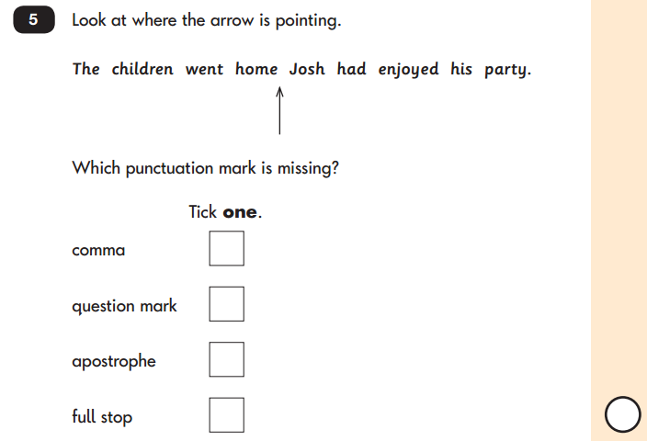
Sample Spelling Punctuation and Grammar

Slide 10
Maths
Children will sit two tests:
• Paper 1 is for arithmetic. It covers calculation
methods for all operations.
• Paper 2 covers problem solving, reasoning
and mathematical fluency.

Slide 11
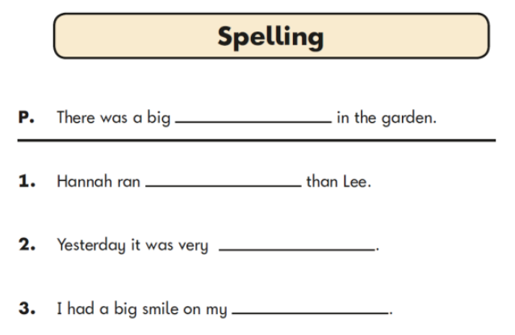
Sample Spelling Punctuation and Grammar

Slide 12
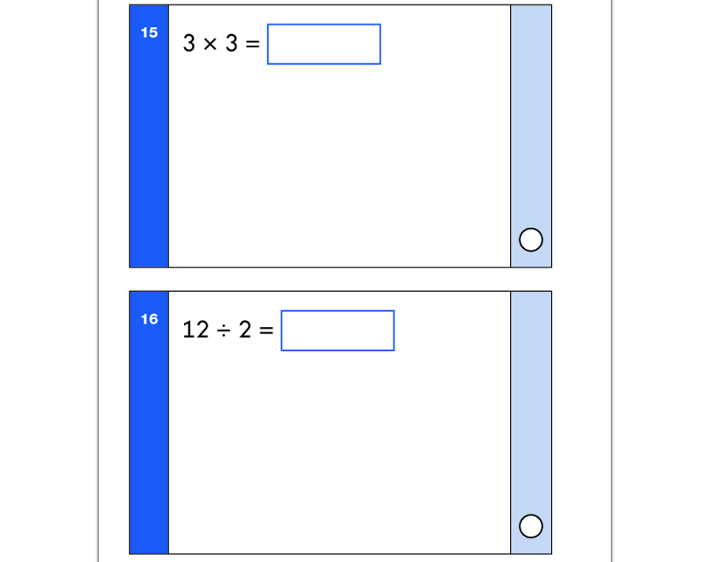
Example: Maths paper 1, Arithmetic

Slide 13
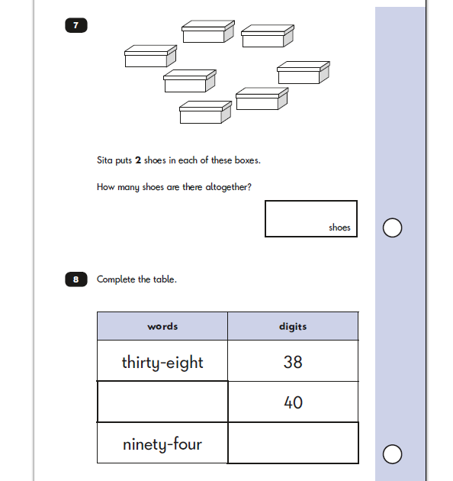
Sample Maths Paper 2 Reasoning

Slide 14
How to help your child
First and foremost, support and reassure your child that there is nothing to worry about and that they should always just try their best. Praise and encourage!
Ensure your child has the best possible attendance at school.
Support your child with any homework tasks.
Reading, spelling and arithmetic (e.g. times tables) are always good to practise.
Talk to your child about what they have learnt at school and what book(s) they are reading (the character, the plot, their opinion).
Make sure your child has a good sleep and healthy breakfast every morning!

Slide 15
Questions
If we are unable to answer your questions today, please fill in one of the question sheets provided and an email address on which we can contact you on. Thank you.

